Slide 1
19CSE313 – Principles of Programming Languages
Haskell Environment & ghci

Slide 2
Haskell interpreters and compilers
Language with many implementations - two are widely used
Hugs interpreter - for teaching
Glasgow Haskell Compiler (GHC) - for real applications
Compiles to native code,
Supports parallel execution, and
Provides useful performance analysis and debugging tools.
GHC Has three main components:
ghc - An optimizing compiler that generates fast native code
ghci - An interactive interpreter and debugger
runghc - A program for running Haskell programs as scripts, without needing to compile them first

Slide 3
Download haskell
https://www.haskell.org/downloads/

Slide 4
ghci - the interactive Interpreter
Allows to
Enter and evaluate Haskell expressions,
Explore modules and
Debug code
Includes a standard library of useful functions - loaded and ready to use.
To use definitions from other modules, we must load them into ghci, using the :module command:
ghci> :module + Data.Ratio
We can now use the functionality of the Data.Ratio module, which lets us work with rational numbers (fractions).
When we load other modules or source files, they will also show up in the prompt.
Getting help
Enter :? at the ghci prompt, it will print a long help message.

Slide 5
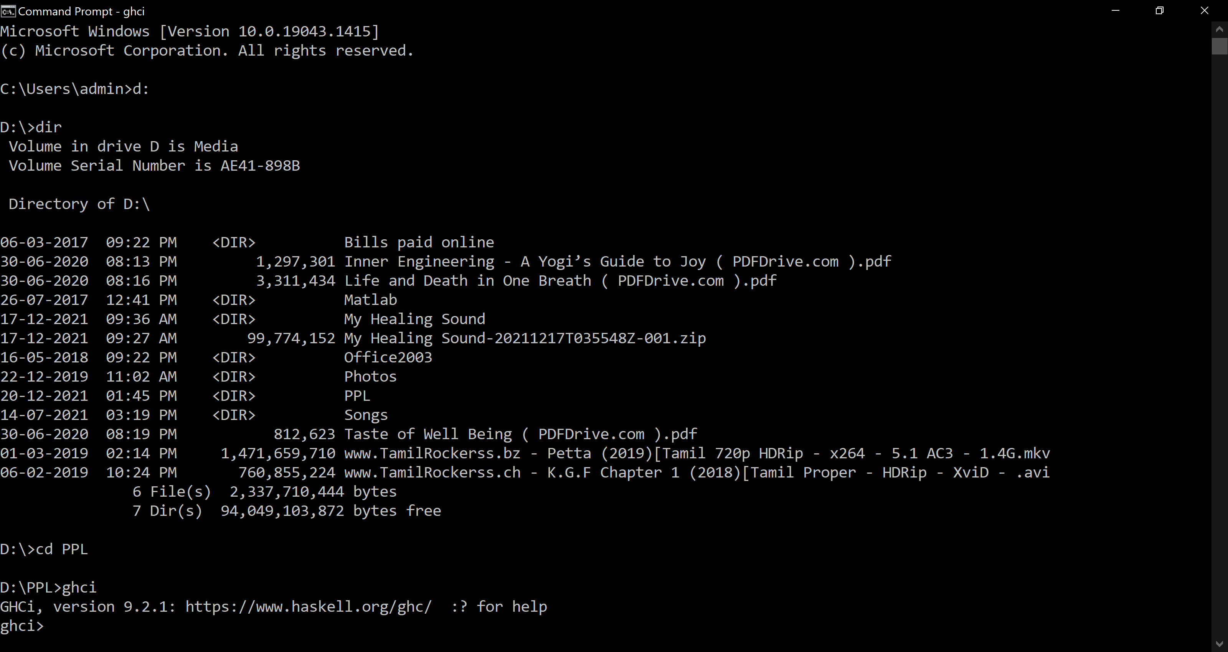
ghci in action

Slide 6
Basic interaction with ghci as a Calculator
Basic arithmetic works similarly to languages such as C and Python
Expressions are written in infix form, where an operator appears between its operands:
ghci> 2+2
4
ghci> 12*12
144
ghci> 9.0/4.0
2.25
ghci>

Slide 7
Some examples of Basic arithmetic in ghci
Expressions can be written in prefix form also:
ghci> (+) 2 2
4
Note: In Prefix form, the operator must be enclosed in parenthesis
Integer Exponentiation:
(^) provides integer exponentiation
Example:
ghci> 2^2
4

Slide 8
Negative Numbers
Unary Minus
Example:
ghci> -3
-3
Using Negative Number in Infix Expression:
ghci> 2 + -3
<interactive>:9:1: error:
Precedence parsing error
cannot mix `+' [infixl 6] and prefix `-' [infixl 6] in the same infix expression
ghci>
The - operator is Haskell’s only unary operator, and we cannot mix it with infix operators

Slide 9
Negative Number in Infix Expression
Negative Numbers must be enclosed in parenthesis in an infix expression to avoid ambiguity
ghci> 2 + (-3)
-1
ghci> 3 + (-(13 * 37))
-478

Slide 10
Usage of space and negative numbers
Most of the time white spaces (Blank, Tab) can be omitted in expressions
Example 1
ghci> 2*3
6
Example 2
ghci> 2*-3
<interactive>:13:2: error:
* Variable not in scope: (*-) :: t0 -> t1 -> t
* Perhaps you meant one of these:
`*>' (imported from Prelude), `**' (imported from Prelude),
`*' (imported from Prelude)
Haskell reads *- as a single operator. Could be used if defined.
Solution:
ghci> 2*(-3)
-6

Slide 11
Logical operators and boolean values
The values of Boolean logic in Haskell are
True
False
Capitalization of these names is important.
Logical Operators:
(&&) is logical “and”
(||) is logical “or”
not - a function is used for negation
Example:
ghci> True && False
False
ghci> False || True ghci> not True
True False

Slide 12
Usage of 0 as false and non zero value as true
Example:
ghci> True && 1
<interactive>:19:9: error:
* No instance for (Num Bool) arising from the literal `1'
* In the second argument of `(&&)', namely `1'
In the expression: True && 1
In an equation for `it': it = True && 1
Haskell does not, nor does it consider a nonzero value to be True

Slide 13
Relational operators in haskell
Most of Haskell’s comparison operators are similar to those used in C and similar languages
Examples:
ghci> 1==1 (Equality operator)
True
ghci> 2<3 (Less than operator)
True
ghci> 4>=3.99 (Greater than or Equal to operator)
True
ghci> 2/=3 (Not equal to Operator)
True

Slide 14
Operator precedence and associativity
Haskell assigns numeric precedence values to operators
lowest precedence is 1 and Highest precedence is 9
A higher-precedence operator is applied before a lower precedence operator in an expression.
ghci’s :info command can be used to check the precedence level of individual operators
Example:
ghci> :info (+)
type Num :: * -> Constraint
class Num a where
(+) :: a -> a -> a
...
-- Defined in `GHC.Num'
infixl 6 +
ghci> :info (*)
type Num :: * -> Constraint
class Num a where
...
(*) :: a -> a -> a
...
-- Defined in `GHC.Num'
infixl 7 *

Slide 15
Overriding precedence using ( )
We can use parentheses to explicitly group parts of an expression, and
Precedence allows us to omit a few parentheses.
Example:
ghci> 1 + (4 * 4)
17
ghci> 1 + 4 * 4
17
Since (*) has a higher precedence than (+), 1 + 4 * 4 is evaluated as 1 + (4 * 4), and not (1 + 4) * 4.
Associativity of operators
Determines whether an expression containing multiple uses of an operator is evaluated from left to right or right to left
The (+) and (*) operators are left associative, which is represented as infixl in :info
A right associative operator is displayed with infixr
Example:
ghci> :info (^)
(^) :: (Num a, Integral b) => a -> b -> a -- Defined in `GHC.Real'
infixr 8 ^
Combination of precedence and associativity rules are usually referred to as fixity
rules
Both Expressions are Equivalent

Slide 16
Constants and variables
Haskell’s Prelude, the standard library, defines at least one well known mathematical constant for us:
ghci> pi
3.141592653589793
Haskell’s coverage of mathematical constants is not comprehensive
ghci> e [where e is the Euler Number]
<interactive>:4:1: error: Variable not in scope: e
We may have to define it ourselves

Slide 17
Defining e using Let construct and its usage
Example 1: Defining e using let
ghci> let e = exp 1
ghci> e
2.718281828459045
exp is the in-built exponential function
Unlike other languages haskell does not require a parenthesis around the arguments to a function
Example 2: Using the defined e in an arithmetic expression
ghci> (e ** pi) - pi
19.999099979189467

Slide 18
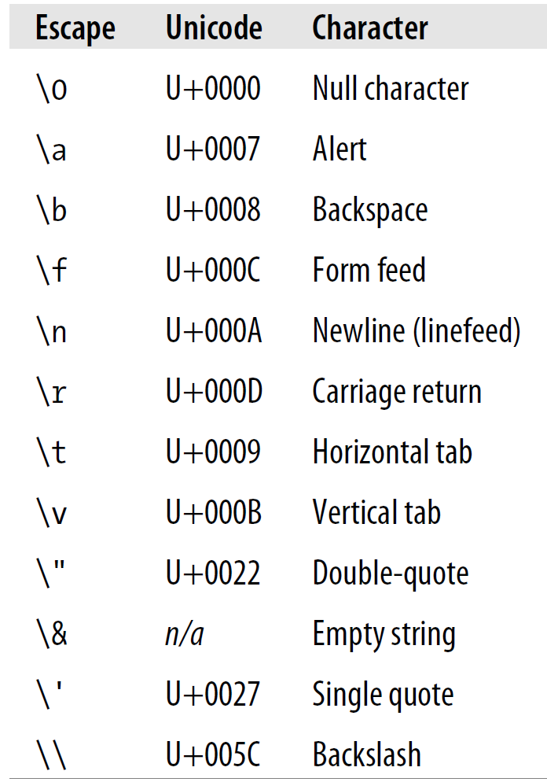
Strings and characters
A text string is surrounded by double quotes Escape Sequences
ghci> "This is a string."
"This is a string.“
Example for \n
ghci> putStrLn "Here's a newline -->\n<-- See?"
Here's a newline -->
<-- See?
The putStrLn function prints a string.
Single Character
ghci> 'a'
'a'

Slide 19
List of characters and lists
ghci> let a = ['l', 'o', 't', 's', ' ', 'o', 'f', ' ', 'w', 'o', 'r', 'k']
ghci> a
"lots of work“
ghci> a=="lots of work"
True
The Empty String “ ” or [ ]
ghci> let b = ""
ghci> b==[]
True
String is actually a list of characters

Slide 20
lists
A list is surrounded by square brackets; the elements are separated by commas
ghci> [1,2,3]
[1,2,3]
Commas are separators, not terminators
ghci> [1,2,]
<interactive>:28:6: error: parse error on input `]‘
A list can be of any length. An empty list is written []:
ghci> []
[]

Slide 21
lists
All elements of a list must be of the same type.
Example 1:
ghci> ["foo", "bar", "baz", "quux", "fnord", "xyzzy"]
["foo","bar","baz","quux","fnord","xyzzy"]
Example 2:
ghci> [True, False, "testing"]
<interactive>:32:15: error:
* Couldn't match type `[Char]' with `Bool'
Expected: Bool
Actual: String
* In the expression: "testing"
In the expression: [True, False, "testing"]
In an equation for `it': it = [True, False, "testing"]

Slide 22
The .. Enumeration notation for lists
Haskell fills in the rest of the items in the list when enumeration notation .. is used.
Example:
ghci> [1..10]
[1,2,3,4,5,6,7,8,9,10]
Can be used only for types whose elements can be enumerated.
Makes no sense for text strings
Example:
ghci> ["foo".."quux"]
<interactive>:35:1: error:
* No instance for (Enum String)
arising from the arithmetic sequence `"foo" .. "quux"'
* In the expression: ["foo" .. "quux"]
In an equation for `it': it = ["foo" .. "quux"]
use of range notation gives a closed interval containing both end points

Slide 23
specifying the size of the step (optional)
Provide the first two elements, followed by the value at which to stop
Example:
ghci> [1.0,1.25..2.0]
[1.0,1.25,1.5,1.75,2.0]
ghci> [1,4..15]
[1,4,7,10,13]
ghci> [10,9..1]
[10,9,8,7,6,5,4,3,2,1]

Slide 24
List operations
Concatenation operator (++):
ghci> [3,1,3] ++ [3,7]
[3,1,3,3,7]
ghci> [] ++ [False,True] ++ [True]
[False,True,True]
“cons” operator (:):
Short form for construct
Adds an element to the front of a list
ghci> 1 : [2,3]
[1,2,3]
ghci> 1 : []
[1]
The first argument of (:) must be an element, and the second must be a list
Try writing [1,2]:3 to add an element to the end of a list

Slide 25
types
Haskell type names must start with an uppercase letter, and variable names must start with a lowercase letter
Setting ghci to print the type of an expression using +t:
Example 1:
ghci> 'c'
'c‘
Example 2:
ghci> :set +t
ghci> 'c'
'c'
it :: Char
Before giving :set +t
After giving :set +t

Slide 26
The cryptic word “it”
The word “it’” is the name of a special variable, in which ghci (not Haskell ! ) stores the result of the last expression we evaluated.
Another Example:
ghci> "Hello"
"Hello"
it :: String
Decoding the above Example:
It tells about the special variable it
The text of the form x :: y is read as “the expression x has the type y.”
In the above expression “it” has the type of String

Slide 27
Other handy uses of “it”
The result of the expression we
just evaluated can be used in a new expression
Example 1:
ghci> "Hello"
"Hello"
it :: String
ghci> it ++ "Haskell"
"HelloHaskell"
it :: [Char]

Slide 28
Other handy uses of “it”
Example 2:
ghci> it++3
<interactive>:9:5: error:
* No instance for (Num [Char]) arising from the literal `3'
* In the second argument of `(++)', namely `3'
In the expression: it ++ 3
In an equation for `it': it = it ++ 3
ghci> it
"HelloHaskell"
it :: [Char]
ghci> it++"World"
"HelloHaskellWorld"
it :: [Char]
When evaluating an expression, ghci won’t change the value of it if the evaluation fails.

Slide 29
Some more examples
ghci> 5
5
it :: Num a => a
ghci> 5.5
5.5
it :: Fractional a => a
ghci> 7^80
40536215597144386832065866109016673800875222251012083746192454448001
it :: Num a => a
Haskell’s integer type is named Num. The size of an Integer value is bounded only by your system’s memory capacity.

Slide 30
Rational numbers
Don’t look quite the same as integers
To construct a rational number, we use the (%) operator.
ghci> :m +Data.Ratio (:m is the short form for :module command)
ghci> 11 % 29
11 % 29
it :: Integral a => Ratio a
ghci> it
11 % 29
it :: Integral a => Ratio a
Read as Ratio of Integer

Slide 31
Ratios of non-integral type
ghci> 3.14 % 8
<interactive>:19:1: error:
* Ambiguous type variable `a0' arising from a use of `print'
prevents the constraint `(Show a0)' from being solved.
Probable fix: use a type annotation to specify what `a0' should be.
These potential instances exist:
instance Show a => Show (Ratio a) -- Defined in `GHC.Real'
instance Show Ordering -- Defined in `GHC.Show'
instance Show a => Show (Maybe a) -- Defined in `GHC.Show'
...plus 24 others
...plus 14 instances involving out-of-scope types
(use -fprint-potential-instances to see them all)
* In a stmt of an interactive GHCi command: print it

Slide 32
Ratios of non-integral type
ghci> 1.2 % 3.4
<interactive>:20:1: error:
* Ambiguous type variable `a0' arising from a use of `print'
prevents the constraint `(Show a0)' from being solved.
Probable fix: use a type annotation to specify what `a0' should be.
These potential instances exist:
instance Show a => Show (Ratio a) -- Defined in `GHC.Real'
instance Show Ordering -- Defined in `GHC.Show'
instance Show a => Show (Maybe a) -- Defined in `GHC.Show'
...plus 24 others
...plus 14 instances involving out-of-scope types
(use -fprint-potential-instances to see them all)
* In a stmt of an interactive GHCi command: print it

Slide 33
Turning ofF the type information
The extra type information can be turned off at any time, using the :unset command
Example
ghci> :unset +t
ghci> 2
2
Type command:
ghci> :type 'a'
'a' :: Char
ghci> "Hi"
"Hi"
ghci> :type it
it :: String
The :type command prints the type information for any expression including it
Type doesn’t actually evaluate the expression; it checks only its type and prints it

Slide 34
Type systems
Every expression and function in Haskell has a type
For example, the value True has the type Bool, while the value "foo" has the type String
The type of a value indicates that it shares certain properties with other values of the same type
For example, we can add numbers and concatenate lists; these are properties of those types
An expression has type X, or is of type X
Aspects of Haskell’s Type System
There are three interesting aspects to types in Haskell
They are strong,
They are static and
They can be automatically inferred

Slide 35
Strong types
The type system guarantees that a program cannot contain certain kinds of errors which doesn’t make sense such as
Using an integer as a function or
If a function expects to work with integers and if a string is passed, it will be rejected by the Haskell compiler
Haskell will not automatically coerce values from one type to another and will raise a compilation error in such a situation
Explicit type conversion must be performed using coercion functions
The benefit of strong typing is that it catches real bugs in our code before they can cause problems
Type Inference
The ability of a Haskell compiler to automatically deduce the types of almost all expressions in a program is known as Type Inference

Slide 36
Static Types
A static type system means that the compiler knows the type of every value and expression at compile time
ghci> True && "false"
<interactive>:27:10: error:
* Couldn't match type `[Char]' with `Bool'
Expected: Bool
Actual: String
* In the second argument of `(&&)', namely `"false"'
In the expression: True && "false"
In an equation for `it': it = True && "false“
Haskell’s combination of strong and static typing makes it impossible for type errors to occur at runtime.
A Haskell compiler or interpreter
will detect when we try to use expressions whose types don’t match, and reject our code with an error message before we run it ! ! !

Slide 37
Some Common Basic Types
Type | Description
Char | Unicode character
Bool | Boolean logic. Possible values: True and False
Int | Signed, fixed-width integers. Exact range of values. depends on the system’s longest “native” integer: 32-bit machine: 32 bits wide, 64-bit machine: 64 bits wide. Haskell standard guarantees only that an Int is wider than 28 bits.
Integer | Signed integer of unbounded size. Not used as often as Ints as more expensive in performance and space. Advantage: No overflow, so reliable results
Double | Floating-point numbers. Typically 64 bits wide. Uses the system’s native floating-point representation

Slide 38



Type inference example Revisited
ghci> :type 'a'
'a' :: Char
ghci> 'a' :: Char
'a'
ghci> [1,2,3] :: Int
<interactive>:30:1: error:
* Couldn't match expected type `Int' with actual type `[a0]'
* In the expression: [1, 2, 3] :: Int
In an equation for `it': it = [1, 2, 3] :: Int
Automatic Type Inference
Explicit type declaration
Type Signature…
But Wrong ! ! !

Slide 39
Function Application (pre-defined functions)
To apply a function in Haskell, write the name of the function followed by its arguments
Examples:
ghci> odd 3
True
ghci> compare 2 3
LT
Function application has higher precedence than operator usage
Example:
ghci> (compare 2 3) == LT
True
ghci> compare 2 3 == LT
True

Slide 40

Usage of parenthesis in compound expressions
ghci> compare (sqrt 3) (sqrt 6)
LT
ghci> compare sqrt 3 sqrt 6
<interactive>:36:1: error:
* Couldn't match expected type `(a0 -> a0) -> t0 -> t'
with actual type `Ordering'
* The function `compare' is applied to four value arguments,
but its type `(a1 -> a1) -> (a1 -> a1) -> Ordering' has only two
In the expression: compare sqrt 3 sqrt 6
In an equation for `it': it = compare sqrt 3 sqrt 6
* Relevant bindings include it :: t (bound at <interactive>:36:1)
Treated as passing four arguments to compare,
instead of two ! ! !

Slide 41
Useful Composite Data Types: Lists and Tuples
The head function returns the first element of a list:
ghci> head [1,2,3,4]
1
Its counterpart, tail, returns all but the head of a list:
ghci> tail [1,2,3,4]
[2,3,4]
ghci> tail [2,3,4]
[3,4]
ghci> tail [True,False]
[False]
ghci> tail "list"
"ist"
ghci> tail []
*** Exception: Prelude.tail: empty list
Because the values in a list can have any type, we call the list type polymorphic !!!

Slide 42

Tuple
As opposed to lists which can have any length with all the elements of same type !
Fixed-size collection of values
Each value can have a different type
A tuple is specified by enclosing its elements in parentheses, separated by commas.
Example:
ghci> (1964, "Labyrinths")
(1964,"Labyrinths")
The same above notation is used for writing a tuple’s type:
ghci> :type (True, "hello")
(True, "hello") :: (Bool, String)
ghci> ()
()

Slide 43
Functions over Lists and Tuples
take - Given a number n and a list, take returns the first n elements of the list
drop -returns all but the first n elements of the list
ghci> take 2 [1,2,3,4,5]
[1,2]
ghci> drop 3 [1,2,3,4,5]
[4,5]
For tuples, the fst and snd functions return the first and second element of a pair, respectively:
ghci> fst (1,'a')
1
ghci> snd (1,'a')
'a'

Slide 44
Passing an Expression to a Function
In Haskell,function application is left-associative
For example: The expression a b c d is equivalent to (((a b) c) d).
To use one expression as an argument to another, use explicit parentheses for correct execution
Example:
ghci> head (drop 4 "azerty")
't‘
ghci> head drop 4 "azerty"
<interactive>:57:6: error:
* Couldn't match expected type: [t0 -> String -> t]
with actual type: Int -> [a0] -> [a0]
* Probable cause: `drop' is applied to too few arguments
In the first argument of `head', namely `drop'
In the expression: head drop 4 "azerty"
In an equation for `it': it = head drop 4 "azerty"
* Relevant bindings include it :: t (bound at <interactive>:57:1)

Slide 45
Sequence of function calls - example
main = do
print(odd 3)
print(compare 2 3)
print(head [1,2,3,4])
print(tail [1,2,3,4])
print(tail "list")
take 2 [1,2,3,4,5]
drop 3 [1,2,3,4,5]

Slide 46
Function Types and Purity
Example: The pre-defined function lines splits a string on line boundaries
ghci> lines "the quick\nbrown fox\njumps"
["the quick","brown fox","jumps"]
Type Signature of a Function: gives a hint as to what the function might actually do
Example:
ghci> :type lines
lines :: String -> [String]
Lines takes one String, and returns many (a list of strings).
The signature is read as “lines has the type String to list-of-String”
-> is read as “to,” which loosely translates to “returns.”

Slide 47
Examples of function signatures
f :: X -> Y
f is a function taking arguments of type X and returning results of
type Y.
sin :: Float -> Float
age :: Person -> Int
add :: (Integer,Integer) -> Integer
logBase :: Float -> (Float -> Float)
Function Call:
sin 3.14 or sin (3.14) or sin(3.14)

Slide 48
Functional composition
Suppose f :: Y -> Z and g :: X -> Y are two given functions. We can combine them into a new function
f . g :: X -> Z
The above applies g to an argument of type X, giving a result of type Y, and then applies f to this result, giving a final result of type Z.
In other words:
(f . g) x = f (g x)
The order of composition is from right to left because we write functions to the left of the arguments to which they are applied.
Example:
ghci> odd(sqr 3)
False
ghci> odd(mod 22 3)
True
ghci> odd(mod 20 3)
False

Slide 49
side effects
Side Effect: Introduces a dependency between the global state of the system and the behavior of a function.
Consider a function that reads and returns the value of a global variable.
If some other code can modify that global variable, then the result of a particular application of our function depends on the current value of the global variable.
The function has a side effect, even though it never modifies the variable itself.
Side effects are essentially invisible inputs to, or outputs from, functions.

Slide 50
Pure and impure functions
In Haskell, the default is for functions to not have side effects: the result of a function depends only on the inputs that we explicitly provide.
Pure Functions: Functions without Side effects
Impure Functions: Functions with Side effects
Identifying an Impure Function:
By reading the type signature
The type of the function’s result will begin with IO
Example:
ghci> :type readFile
readFile :: FilePath -> IO String
Haskell’s type system prevents us from accidentally mixing pure and impure code

Slide 51
Haskell Source Files, and Writing Simple Functions
Simple functions in Haskell
Haskell source files are usually identified with a suffix of .hs
A simple function named add.hs is defined as follows
add a b = a + b
Haskell doesn’t have a return keyword, because a function is a single expression, not a sequence of statements.
The value of the expression is the result of the function.
= symbol in Haskell code, it represents “meaning”—the name on the left is defined to be the expression on the right.
name of the function followed by the arguments to the function
the body of the function

Slide 52
Running the function
Save the source file
Load it into ghci
Use the add function straightaway
Sample run of add.hs
ghci> :load add.hs
[1 of 1] Compiling Main ( add.hs, interpreted )
Ok, one module loaded.
ghci> add 1 2
3
When we apply add to the values 1 and 2, the variables a and b on the lefthand side of our definition are given (or “bound to”) the values 1 and 2, so the result is the expression 1 + 2.

Slide 53
Types of functions in haskell
With arguments and with return type
With arguments and without return type
add ::Int->Int->Int
add x y = x+y
main = do
print(add 4 5)
add :: Int->Int->IO()
add x y = print(x+y)
main = do
add 3 4

Slide 54
Types of functions in haskell
Without arguments and with return type
Without arguments and without return type
add :: ()->Int
add () = do
let b = 5
b+0
main = do
print(add())
add = do
let a= 5
let b=5
print(a+b)
main = do
add

Slide 55
Variables in haskell
In Haskell, a variable provides a way to give a name to an expression.
Once a variable is bound to (i.e., associated with) a particular expression, its value does not change.
We can always use the name of the variable instead of writing out the expression, and we will get the same result either way
For example, if we run the following tiny Python script, it will print the number 11:
x = 10
x = 11
# value of x is now 11
print x

Slide 56
Variables in haskell
In contrast, trying the equivalent in Haskell results in an error:
-- file: ch02/Assign.hs
x = 10
x = 11
ghci> :load assign.hs
[1 of 1] Compiling Main ( assign.hs, interpreted )
assign.hs:3:1: error:
Multiple declarations of `x'
Declared at: assign.hs:2:1
assign.hs:3:1
|
3 | x = 11
| ^
Failed, no modules loaded.

Slide 57
Conditional Evaluation
Haskell has an if expression: if test then expr1 else expr2
An expression of type Bool, immediately following the if. We refer to this as a predicate.
A then keyword, followed by another expression. This expression will be used as the value of the if expression if the predicate evaluates to True.
An else keyword, followed by another expression. This expression will be used as the value of the if expression if the predicate evaluates to False.
The expressions that follow the then and else keywords as “branches.”
The branches must have the same types; the if expression will also have this type. An expression such as if True then 1 else "foo" has different types for its branches, so it is ill typed and a compiler or interpreter will reject

Slide 58
Conditional Evaluation
Example:
doubleSmallNumber x = if x > 100
then x
else x*2
if even x then y else (x + y)
ghci> :type if 1==0 then 'a' else "a"
<interactive>:1:23:
Couldn't match expected type `Char' with actual type `[Char]'
In the expression: "a"
In the expression: if 1 == 0 then 'a' else "a"
GHCi expects the types of expr1 and expr2 in a conditional expression if test then expr1 else expr2 to be the same.

Slide 59
Function evaluation
Example:
isOdd n = mod n 2 == 1 [mod - standard modulo function]
Consider the evaluation of (1+2)
In usual languages:
First, evaluate the subexpression 1 + 2, to give 3
Apply the odd function with n bound to 3
Finally, evaluate mod 3 2 to give 1, and 1 == 1 to give True
Strict and Non-Strict Evaluation:
In languages that uses strict evaluation, the arguments to a function are evaluated before the function is applied.
Haskell uses non-strict evaluation

Slide 60
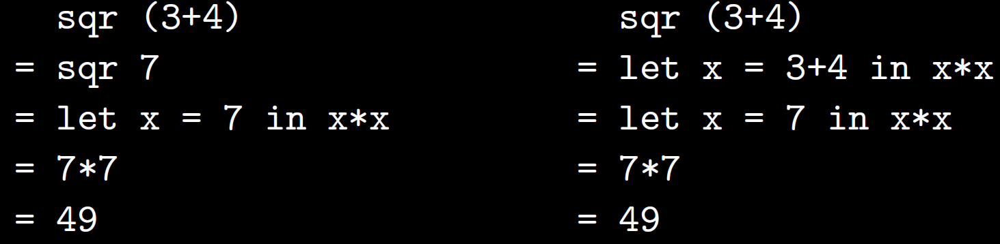
Function evaluation
Consider the evaluation of the function sqr(3+4) where sqr is defined as:
sqr :: Integer -> Integer
sqr x = x*x
There are basically two ways to reduce the expression sqr (3+4) to its simplest possible form, namely 49.
Either evaluate 3+4 first, or apply the definition of sqr first:
The number of reductions is same in both cases, but order is different
Method on left is strict / eager evaluation and method on the right is lazy evaluation

Slide 61
Haskell’s non-strict or lazy evaluation
In Haskell, the subexpression 1 + 2 is not reduced to the value 3
Instead, a “promise” is created that when the value of the expression isOdd (1 + 2) is needed, it will be able to compute it
Thunk: The record used to track an unevaluated expression
A thunk is created and the actual evaluation is deferred until it is really needed
If the result of this expression is never subsequently used, we will not compute its value at all.

Slide 62
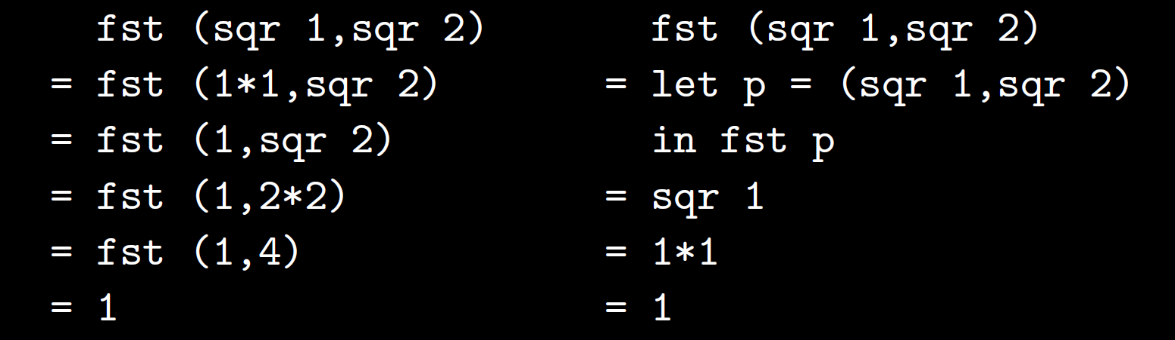
lazy evaluation - Example
fst (x,y) = x
Under eager evaluation the value sqr 2 is computed, while under lazy evaluation that value is not needed and is not computed.

Slide 63
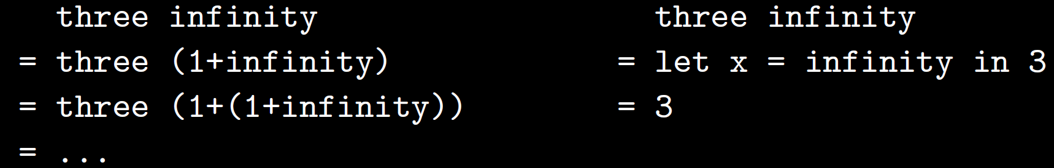
lazy evaluation - Example
Consider the definitions:
infinity :: Integer
infinity = 1 + infinity
three :: Integer -> Integer
three x = 3
There are two ways to evaluate three infinity
Evaluating infinity will cause GHCi to go into a long, silent think trying to compute 1 + (1 + (1 + (1 + (1 + .... until eventually it runs out of space and returns an error message. The value of infinity is ⊥.
Here eager evaluation gets stuck in a loop trying to evaluate infinity, while lazy evaluation returns the answer 3 at once.
We don’t need to evaluate the argument of three in order to return 3.

Slide 64
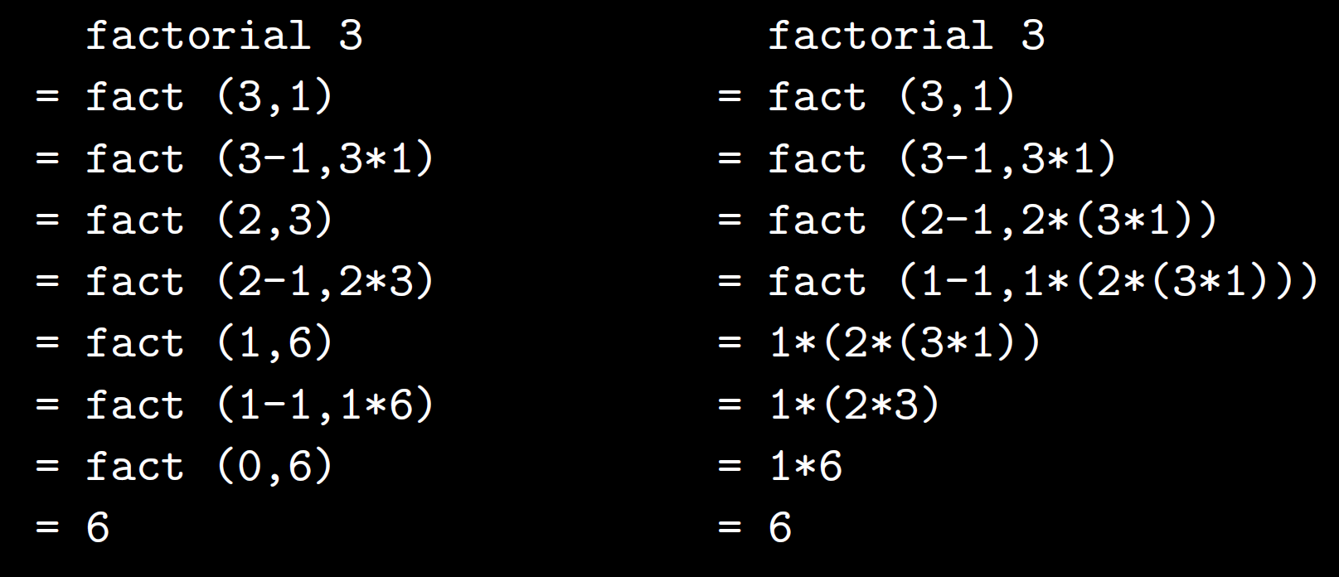
recursion
The number of reduction steps is basically the same but lazy evaluation requires much more space to achieve the answer ! The expression 1*(2*(3*1)) is built up in memory before being evaluated.
factorial :: Integer -> Integer
factorial n = fact (n,1)
fact :: (Integer,Integer) -> Integer
fact (x,y) = if x==0 then y else fact (x-1,x*y)
The expression 1*(2*(3*1)) is built up in memory before being evaluated.

Slide 65
pros and cons of lazy evaluation
On the plus side, Lazy evaluation terminates whenever any reduction order terminates; it never takes more steps than eager evaluation, and sometimes infinitely fewer.
On the minus side, it can require a lot more space and it is more difficult to understand the precise order in which things happen.
While Haskell uses lazy evaluation, ML (another popular functional language) uses eager evaluation.
The function three is non-strict, while (+) is strict in both arguments.
Because Haskell uses lazy evaluation we can define non-strict functions.
Hence Haskell is referred to as a non-strict functional language.

Slide 66
Conditional Evaluation – an example with drop
ghci> drop 2 "foobar"
"obar"
ghci> drop 4 "foobar"
"ar"
ghci> drop 4 [1,2]
[]
ghci> drop 0 [1,2]
[1,2]
ghci> drop 7 []
[]
ghci> drop (-2) "foo"
"foo"
Drop returns the original list if the number to remove is less than or equal to zero. Otherwise, it removes elements until it either runs out or
reaches the given number.

Slide 67
myDrop function
Uses Haskell’s if expression to decide what to do
-- file: ch02/myDrop.hs
myDrop n xs = if n <= 0 || null xs
then xs
else myDrop (n - 1) (tail xs)
null function below checks whether a list is empty !
xs - common naming pattern for lists !!!
Indentation is important: it continues an existing definition, instead of starting
a new one.
Don’t omit the indentation !!!

Slide 68
Executing mydrop
Save the Haskell function in a file named myDrop.hs, then load it into ghci:
ghci> :load myDrop.hs
[1 of 1] Compiling Main ( myDrop.hs, interpreted )
Ok, modules loaded: Main.
ghci> myDrop 2 "foobar"
"obar"
ghci> myDrop 4 "foobar"
"ar"
ghci> myDrop 4 [1,2]
[]
ghci> myDrop 0 [1,2]
[1,2]
ghci> myDrop 7 []
[]
ghci> myDrop (-2) "foo"
"foo"

Slide 69
i/o in haskell – A simple example
putStrLn writes out a String, followed by an end-of-line character
main = do
putStrLn "Hello, what's your name?"
name <- getLine
putStrLn ("Hey " ++ name ++ ", you rock!")
ghci> :l nameio.hs
[1 of 1] Compiling Main ( nameio.hs, interpreted )
Ok, one module loaded.
ghci> main
Hello, what's your name?
John
Hey John, you rock!
getLine reads a line from standard input and binds via <- to the name inpStr
list concatenation operator ++ can join the input string with our own text

Slide 70
types of putStrLn and getLine
ghci> :type putStrLn
putStrLn :: String -> IO ()
ghci> :type getLine
getLine :: IO String
Both of these types have IO in their return value
They may have side effects, or they may return different values even when called with the same arguments, or both.
The () is an empty tuple (pronounced “unit”), indicating that there is no return value from putStrLn.

Slide 71
A side-effect example with putstrln:
ghci> let writefoo = putStrLn "foo"
ghci> writefoo
foo
The output foo is not a return value from putStrLn.
It’s the side effect of putStrLn actually writing foo to the terminal.
ghci actually executed writefoo.
This means that, when given an I/O action, ghci will perform it for you on the spot.

Slide 72
an example of calling pure code from within an I/O action
A Regular Haskell function, obeys all the rules : always returns the same result when given the same input, has no side effects, operates lazily. It uses other Haskell functions: (++), show, and length.
name2reply :: String -> String
name2reply name =
"Pleased to meet you, " ++ name ++ ".\n" ++
"Your name contains " ++ show (length name) ++ " characters."
main :: IO ()
main = do
putStrLn "Greetings once again. What is your name?"
inpStr <- getLine
let outStr = name2reply inpStr
putStrLn outStr
ghci> :l io1.hs
[1 of 1] Compiling Main ( io1.hs, interpreted )
Ok, one module loaded.
ghci> main
Greetings once again. What is your name?
John
Pleased to meet you, John.
Your name contains 4 characters.

Slide 73
Reading A number in haskell
main = do
putStrLn ("Enter a number:")
x <- getLine
let num = read x :: Int
print(num)
ghci> main
Enter a number:
4
4

Slide 74
Checking data conversion
import Data.Typeable(typeOf)
main = do
x <- getLine
print(typeOf(x)) -- display the type before conversion
let num = read x:: Int
print(typeOf(num)) --display the type after conversion
ghci> :l numreadtype.hs
[1 of 1] Compiling Main ( numreadtype.hs, interpreted )
Ok, one module loaded.
ghci> main
5
[Char]
Int

Slide 75
Customised string to datatype function
str2Int::String->Int --custconvint.hs
str2Int x = read x :: Int
main = do
putStrLn ("Enter number1:")
input1 <- getLine
let num1 = str2Int input1
print(num1)
putStrLn ("Enter number2:")
input2 <- getLine
let num2 = str2Int input2
print(num2)
Enter number1:
23
23
Enter number2:
42
42
ghci>

Slide 76
Menu driven calculator
--addprint.hs
str2Int::String->Int
str2Int x = read x :: Int
add::(Int,Int)->Int
add(x,y) =
(x+y)
sub::(Int,Int)->Int
sub(x,y) =
(x-y)
main = do
putStrLn ("Enter number1:")
input1 <- getLine
let num1 = str2Int input1
putStrLn ("Enter number2:")
input2 <- getLine
let num2 = str2Int input2
putStrLn ("Enter option: 1.add, 2. sub")
input3 <- getLine
let num3 = str2Int input3
putStrLn "The result is:"
if num3 == 1
then print(add(num1,num2))
else print(sub(num1,num2))

Slide 77
Menu driven calculator - output
ghci> :l addprint.hs
[1 of 1] Compiling Main ( addprint.hs, interpreted )
Ok, one module loaded.
ghci> main
Enter number1:
34
Enter number2:
23
Enter option: 1.add, 2. sub
1
The result is:
57
ghci> main
Enter number1:
34
Enter number2:
23
Enter option: 1.add, 2. sub
2
The result is:
11

